Slide 1
Experiments with scene text recognition
Chen-Yu Lee
Phuc Xuan Nguyen

Slide 2
Overview
Input
Image
SVM + HOG
Character Re-scoring
Solver
Prediction

Slide 3
Character detection and recognition

Slide 4
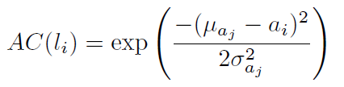
Proposed Character Detector

Slide 5
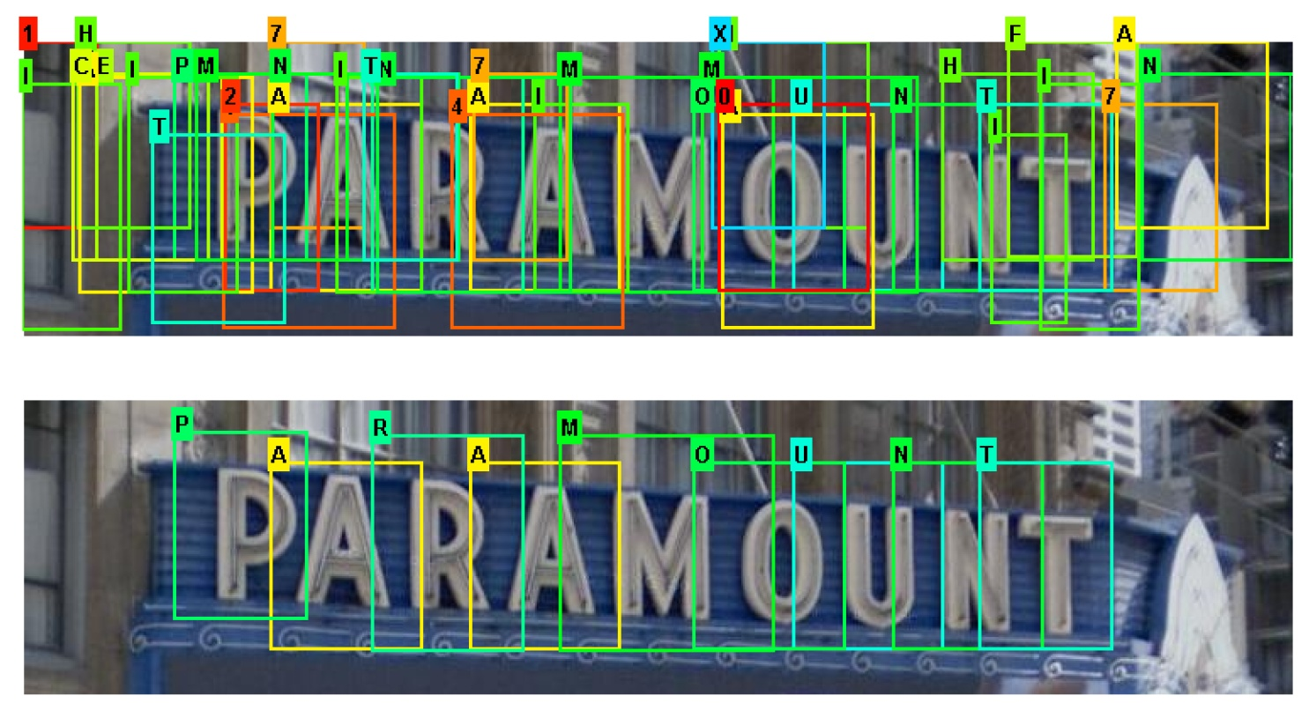
Responses

Slide 6
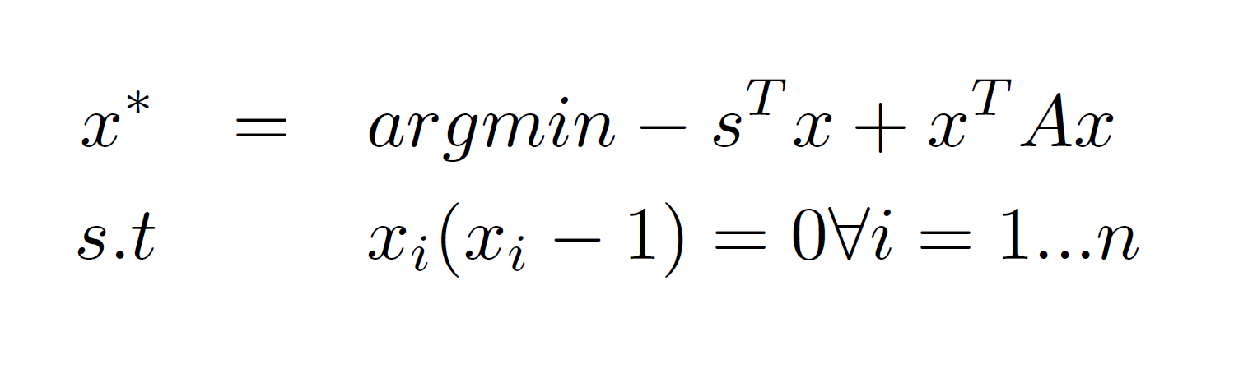
Convex Optimization - Primal
classification scores
cost matrix

Slide 7
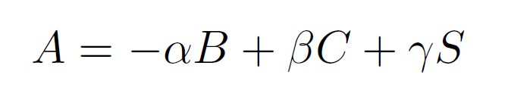
Constructing cost matrices
Bigram probability
Collision
Color similarity

Slide 8
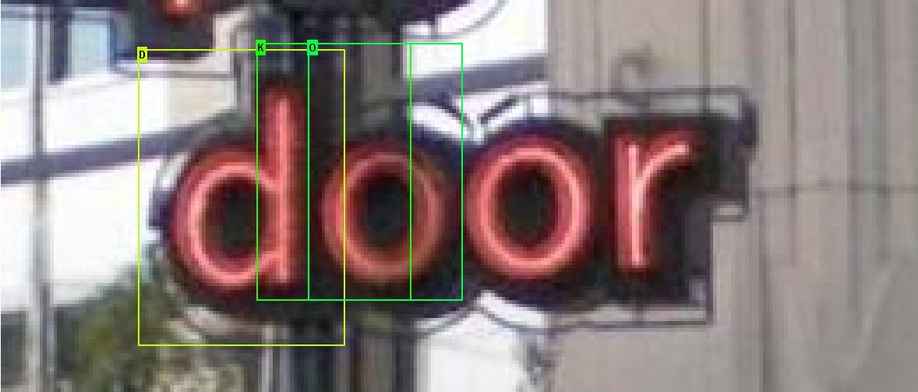
Reasons for cost matrices - Collision

Slide 9
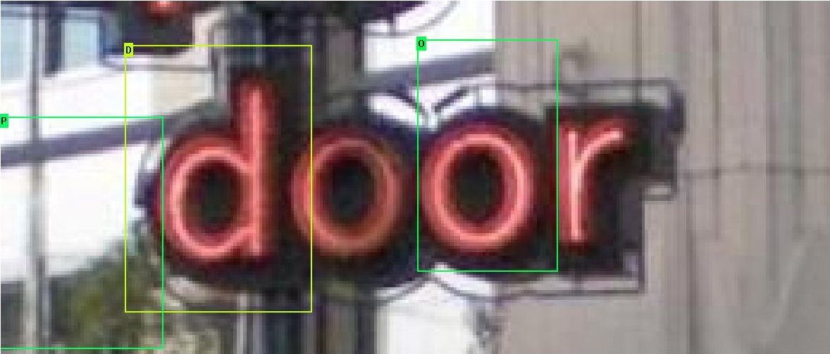
Reasons for cost matrices – Color similarity

Slide 10
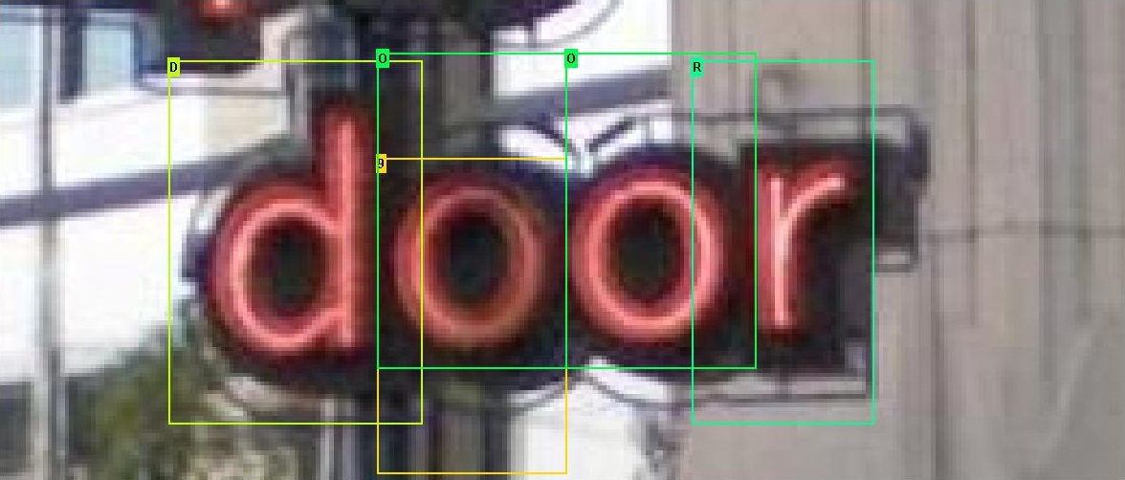
Reasons for cost matrices – Bigram

Slide 11
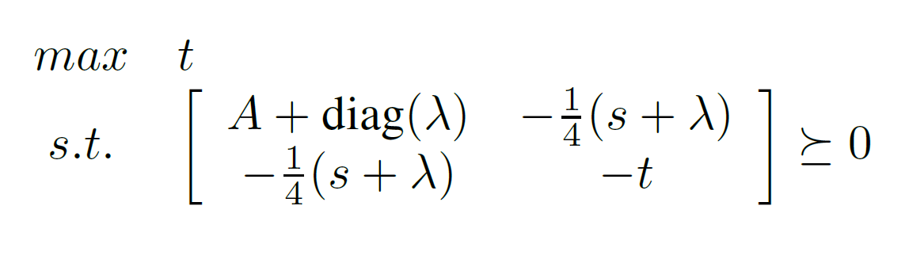
Dual SDP

Slide 12
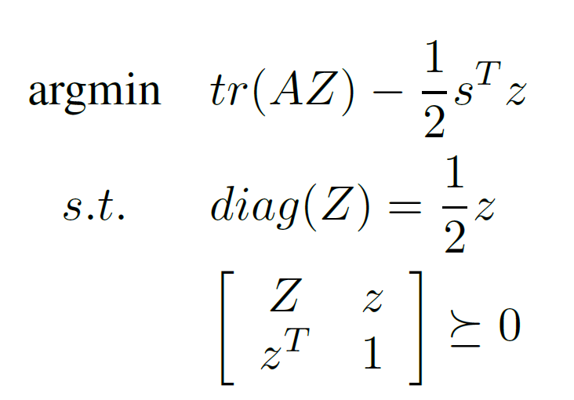
Relaxation of the primal

Slide 13


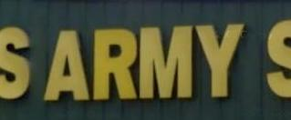
Experiments
Training data: Char-74K, ICDAR 2003, synthetic data
Features: Histogram of Gradient
Classifier: SVM with RBF kernel
Lexicon: 427 words

Slide 14
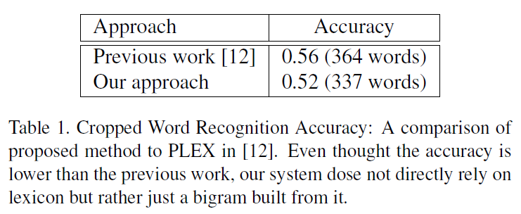
Results
Character detection:
Random Ferns + HOG: 54% (previous)
SVM + HOG: 85% (proposed)

Slide 15
Result

Slide 16

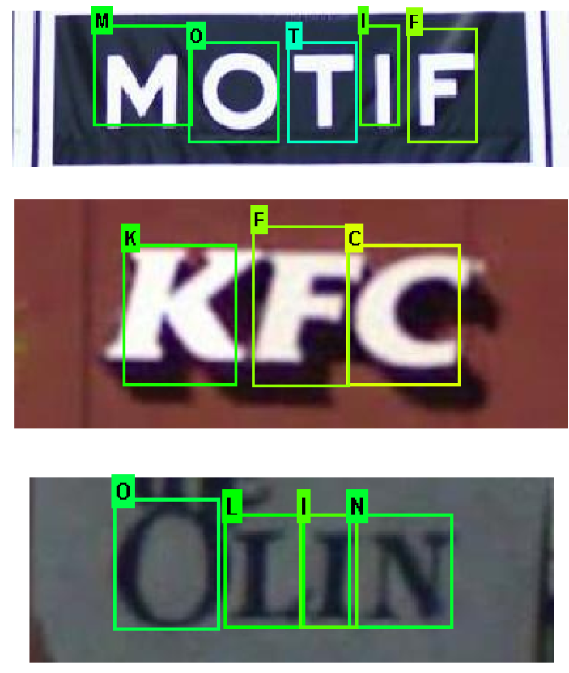
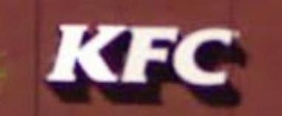
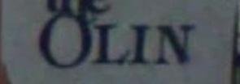
Experiments

